Slide 1
Learning Objectives
AT THE END OF THIS SESSION , YOU WILL BE ABLE TO
UNDERSTAND WHY CONFLICTS ARISE , BETWEEN COMPLAINANTS AND THE ACCUSED.
ABLE TO RESOLVE THEIR CONFLICTS EFFECTIVELY.
VARIOUS STAGES OF CONFLICT, AND WHAT WE SHOULD DO AT EACH STAGE !
HOW PEOPLE BEHAVE IN CONFLICT SITUATIONS
RESOLUTION METHODS AND PROCESSES.
HOW TO COOL DOWN EMOTIONS, IN POTENTIALLY CHARGED SITUATIONS.

Slide 2
ICE BREAKER
Let us take 6 relationships. Each team will take one relationship.
Could be 2 married brothers / hub-wife / boss-subordinate / 2 neighbors / 2 religious groups / parents-children / seniors-juniors .
Each team, to identity 4 potential causes for conflicts. Regroup and discuss for 5 minutes.
1 presenter from each group. 2 minutes.
Total time : 15 to 20 minutes.

Slide 3
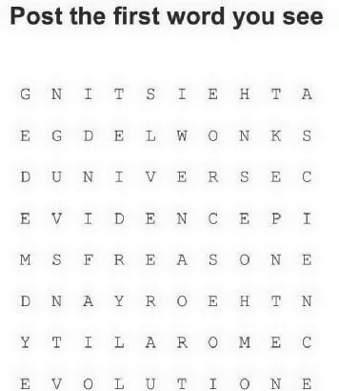

Slide 4
What is a conflict ? Why do they arise between people ?
Are Conflicts, limited to certain relatiany relationship?
Examples ?
Conflict is Perceived differences of needs , values and goals .
Part of a relationships
What is a conflict ?

Slide 5
What are the negatives of a conflict ?
What are the positive fall outs of a conflict ?
Negative and positive consequences

Slide 6
What is a conflict ? Why do they arise between people ?
Are Conflicts, limited to certain relationships, are can happen in any relationship?
Examples ?
Conflict is Perceived differences of needs , values and goals .
Part of a relationships
What is a conflict ?

Slide 7
Conflict is..
Conflict is not…
Conflict is not..
Perceived difference needs, values and goals
Part of a relationship
Consequence of growth change
Sign of a bad relationship
Negative experience
Mistake
Struggle between right and wrong

Slide 8
Diffuse more serious conflicts
Stimulate search for new facts or solutions
Enhance relationships
Increase cohesiveness
Conflict should be managed not eliminated
Advantages of Conflict

Slide 9
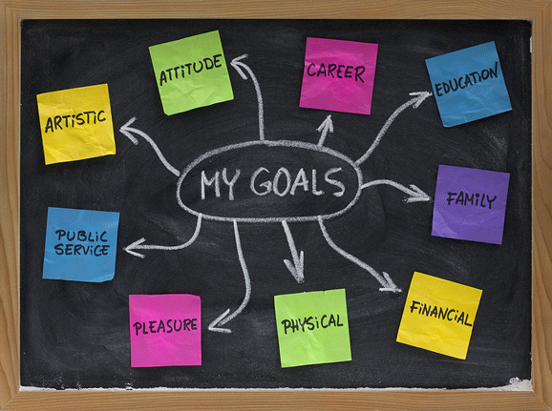

Slide 10
Inevitable
Conflict is:
Necessary
Useful
Take Home Message

Slide 11
Time consuming
Disrupts progress/ problem solving
Detracts from job at hand
Keeps people apart; if unresolved
Poor quality, lowers productivity
Reduces team effectiveness
Disavantages of Conflict

Slide 12
Perception of threat to :
Security
Power
Reward System
Goals
Autonomy
Values and beliefs
Q : How do you see the difference between real threat and ‘ perception ‘ of threat , among complainants in conflicts ? Recent examples ? Does your counselling differ ?

Slide 13
Due to lack of -
Consideration
Appreciation
Misunderstanding
Bad handling
Awareness of its existence is a precondition
Conflict – genesis 2

Slide 14
Due to social / psychological / economic reasons… but….
80 % due to emotions and fear factor
Most conflicts are structural. Not personality related. (Fundamental Attribution Error.)
Never underestimate emotional element and handle that first !
3 broad reasons for conflicts …

Slide 15
When you are handling an emotionally charged situation, what’s your trusted response ?
What do you usually do ? Voluntary responses !
Any other responses ?
There are 10 possible ways
How do you Cool down emotions of parties , during a conflict ?

Slide 16
Not all methods work in all situations. You need to be selective and context conscious !
Maintain eye contact with all parties .
1. Goal : humour . ‘ Common , laugh it off . Only in some situations. Not all .
2. Goal : Make people look at the big picture and long time future .
Dialogue : Don’t let this small incident , spoil every thing .
3. Goal : Distraction . Dialogue : Let us take a break. Change the topic , talk something else. Bring them back.

Slide 17
4. Goal : Handling worry and asking for help .
Dialogue : Who have you spoken about this ?
5. Goal : Offering Hope
Dialogue : Now it looks bad, but you will get through this.
6. Goal : Positive reframing .
What can you learn from this , so that it won’t happen next time ?
Cool down emotions 4-6

Slide 18
7 . Goal : Acceptance.
Dialogue : Don’t worry . Let us see what happens .
8 . Goal : Perspective.
Dialogue : This is not the end of the world.
9. Goal : Flexible Thinking .
You may be right . But have you thought of … fill in the blanks.
10 . Goal : Take action.
Dialogue : What can we do about this ?
Cool down , methods 7-10

Slide 19
ROLE PLAY

Slide 20
1. Control the emotions first . Of complainants & respondents.
2. Attack the problem , not the person
3. Talk about facts, events, and damage done. Feelings can be expressed, but no blame game!
4. They can tell the issue . But not how to handle it.
12 strategies to resolve conflicts

Slide 21
5. individual opinions may differ, don’t try
to force compliance.6. Do not review the situation as a competition, where one has to win and one has to lose. We lost it , when we let them feel so.
7. Focus on areas of common interest and agreement, instead of areas of disagreement .
8. NEVER jump to conclusions or make assumptions about what another is feeling or thinking
12 ways to resolve a conflict – contd..

Slide 22
9. Listen without interrupting
10.Remember, when only one person’s needs are satisfied in a conflict, it is NOT resolved and will continue !
11. Forget the past and stay in the present
12. Build ‘power with’ NOT ‘power over’ others.
12 ways to resolve a conflict

Slide 23
Latent Conflict
Perceived Conflict
Felt Conflict
Manifest Conflict
Stages of a Conflict

Slide 24
Competing
Collaborating.
Aggression
Withdrawal.
Compromising.
Q : How do we resolve, when we find people in each of these stages ?
How do people respond to conflicts?

Slide 25
Is conflict related to
Facts ? ( easy or difficult ? )
Goals ? ( easy or difficult ? )
Methods employed ? ( easy or difficult ? )
Bad Handling? ( easy or difficult ? )
Differing value and belief systems ? ( easy or difficult? )
Before we resolve, let us figure out…

Slide 26
Do-ability test –
Is this doable? Practicable?
Durability test-
Is this durable?
Interest test -
Does this meet all parties’ interests?
After you find solutions – 3 Litmus Tests !

Slide 27
What is the most important point you learned, that is most useful in your job ? ( each one )
As a result of this training session, what do you do differently ?
3 broad categories of conflicts ?
Among the 10 ways to cool down, which you liked most ? Which one you are most uncomfortable with, using? ( Individual)
What are the 3 litmus tests ?
Session Wrap Up

